Slide 1
IPR Term 2 Week 3
CORRELATION
Part two
Dr Hayley Dewe
(Assistant Professor)

Slide 2
Learning Outcomes
After today and next week…
Understand the purpose of correlation tests (Pearson’s r and Spearman’s) and when to use them.
Understand key differences between Pearson’s and Spearman’s tests
Run both tests using JASP software.
Write up and interpret the results following APA standards.
Online content: Run the tests using JASP software using the ‘How to’ videos

Slide 3
Lesson Outline
Reading JASP output
Recap: Week 2 Online content
Interpretation and Write up of Correlation
Activity Worksheets (lecture and online content)

Slide 4

Reading JASP output

Slide 5
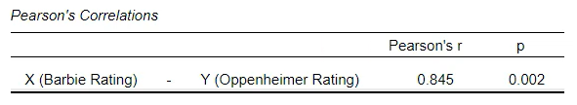
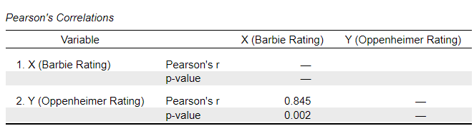
Reading JASP Output
Variables being compared (“Display pairwise”)
If you didn’t select that, it’ll look like this…

Slide 6
Reading JASP Output
Type of test (e.g., Pearson’s or Spearman’s)
Correlation coefficient.
Either Pearson’s (r) or Spearman’s (p).
The number/value tells you the strength or size of the relationship
The sign tells if you the direction (positive or negative)

Slide 7
Reading JASP Output
Significance value or p-value (of the correlation coefficient)
Compare to α – alpha level of significance (default = 0.05)
If p < α = significant relationship, reject H₀
If p > α = not significant (non-significant relationship, fail to reject H₀

Slide 8
2. RECAP: Week 2 Online content

Slide 9
Week 2 Online Content
Pearson’s r
Spearman’s rank (rho)
Research question:
If ratings for the film Barbie, relate to ratings of the film Oppenheimer.
10 x participants
Rating scale: 1 – 10 (10 = highest preference)
Hypothesis: two-tailed, no direction
Predict a relationship but not sure if positive or negative.
Research question:
If social media use (TikTok hours) relates to academic performance (class ranking position)
10 x participants
Rating scale: ranked position (1st = best performance)
Hypothesis: one-tailed, positive direction
As social media hours increase, the higher your ranking (worst performance)

Slide 10
Week 2 Online Content
Pearson’s r
If ratings for the film Barbie, relate to ratings of the film Oppenheimer.
Rating scale: 1 – 10 (10 = highest preference)
Hypothesis: two-tailed
Pearson’s r = .85 (positive number, round)
Significance value p = .002. Compare this against alpha criterion (α = .05)
p value is lower than alpha level (.002 < .05) = significant
= A significant positive relationship - as ratings for Barbie increased, ratings for Oppenheimer increased.

Slide 11
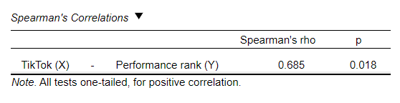
Week 2 Online Content
Spearman’s rank (rho)
If social media use (TikTok hours) relates to academic performance (class ranking position).
Hypothesis: one-tailed, positive direction
Spearman’s rho = .69 (positive number, round)
Significance value p = .018. Compare this against alpha criterion (α = .05)
p value is lower than alpha level (.018 < .05) = significant
= A significant positive relationship - as hours spent on social media (TikTok) increased, academic performance rating increased (higher class ranking). Always be clear what high/low scores mean on your variables. Here a higher ranking = poorer performance (e.g., ranking 10th position vs 1st)

Slide 12
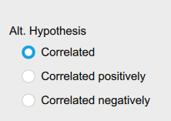
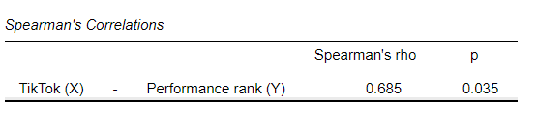
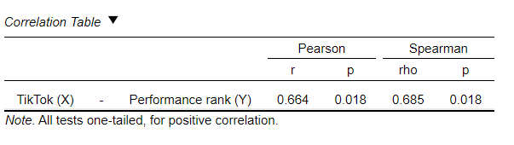
Week 2 Online Content
Errors?
Did you get p = .035?
Did you keep it as two-tailed (Correlated) instead of changing it to one-tailed? (Correlated positively)
Note: correlation coefficient (strength and direction) won’t change, but p-value will.
Try both Pearson and Spearman. Often, there’s little difference (unless the data majorly violate an assumption)

Slide 13
3. Interpretation And write up

Slide 14
Write up Checklist
For all analysis tests, there are standard requirements by the APA on how to write it up (e.g. in a lab report or paper)
We write certain values/criteria in a set order. But certain things can be more flexible and provide a chance for a more independent answer (e.g. avoid plagiarism)
e.g. your interpretation and description of the result can be different.

Slide 15


Write up Checklist
Test type: Pearson’s or Spearman’s
Variables: measures being correlated. Include range/unit
Test statistic (r or p)
Df (degrees of freedom)
p-value
Significance: significant or not/non-significant
Direction (interpret): details or direction e.g., positive or negative, what it means re. variables
In this order

Slide 16
Write up Checklist
Test type: Pearson’s or Spearman’s
Variables: measures being correlated. Include range/unit
Test statistic (r or p)
Df (degrees of freedom)
p-value
Significance: significant or not/non-significant
Direction (interpretation): details or direction e.g., positive or negative, what it means re. variables
Some flexibility for these, where you can write more in your own words.

Slide 17
Write up Checklist
Test type: Pearson’s or Spearman’s
Variables: measures being correlated. Include range/unit
Test statistic (r or p)
Df (degrees of freedom)
p-value
Significance: significant or not/non-significant
Direction (interpretation): details or direction e.g., positive or negative, what it means re. variables
These three are written within a…
LINE of results
(like we did for the Chi-square test)

Slide 18
Write up Correlation (aka the LINE)
r (df) = XX.XX, p = .XXX
State the test statistic test you calculated
df = degrees of freedom.
Calculated test statistic value
The associated significance
p-value
Pearson’s is r
Spearman’s is p.
In Italics.
Calculate df (Sample size minus 2). Not in JASP output. (0 decimal places unless corrected)
Correlation coefficient (r or p) (2 decimal places)
Report EXACT p-value (3 decimal places)
(e.g., p = .042 OR p < .001)
APA: drop leading zero for values that can’t exceed 1 (e.g., r, p) but keep for values that can exceed 1 (e.g., t, means, SDs).
This is APA standards. And very important! Please note:
Where I have put spaces
How many decimal places
Notice r and p are in Italics
If the p value output says .000, write as p < .001 (never ‘<=‘ )
No leading zeros for p, so p = .444 instead of p = 0.444

Slide 19
Example write up: Pearsons’ Correlation
A Pearson’s r correlation looked at the relationship between film preference ratings for the film Barbie and the film Oppenheimer. The rating scale was between 1-10 (with 10 being the highest preference) and a significant relationship was predicted. There was a significant positive relationship, r (8) = .85, p = .002, which indicates a large effect. It suggests that, as preference ratings for the Barbie film increased, ratings for the Oppenheimer film also increased.
(remember these examples are just that: examples of phrasing and style. You can vary it, just make sure you include everything from the checklist)

Slide 20
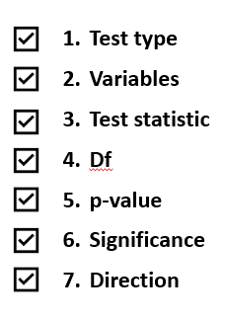
Example write up: Pearsons’ Correlation
A Pearson’s r correlation looked at the relationship between film preference ratings for the film Barbie and the film Oppenheimer. The rating scale was between 1-10 (with 10 being the highest preference) and a significant relationship was predicted. There was a significant positive relationship, r (8) = .85, p = .002, which indicates a large effect. It suggests that, as preference ratings for the Barbie film increased, ratings for the Oppenheimer film increased.
Never say “insignificant”!
Also added interpretation of the size of the effect (large, according to Cohen) – extra and useful (you’ll need to do this as standard for other tests, e.g. t-tests)

Slide 21
Reporting Assumptions
You don’t typically report/explain that each assumption was checked when assumptions were met. It’s assumed you’ve checked it and ran the appropriate test – so make sure you do!
However, unless.
we specifically ask you to report them (e.g. in exams)
you violated assumptions so are using a Non-Parametric test (generally good practice)
you found/removed/kept outliers (best practice to tell the reader what you did with them)
you transformed the data, or are using corrected values or (more in upcoming weeks)
a dissertation supervisor, reviewer, editor or colleagues request it
Check: papers of interest, read analyses/results sections – notice how many report assumptions if they are met. Notice when/how it’s written if assumptions are violated.

Slide 22
4. Activities
For the remainder of the lecture and for your ‘Online Content’ hour: go to Ultra and work through the activity worksheets
(released during the lecture)

